Slide 1

Financial & Managerial
Accounting
The Basis for Business Decisions
SIXTEENTH EDITION
Williams Haka Bettner Meigs

Slide 2

Chapter
1
ACCOUNTING:
Information for Decision Making
Notes:
2

Slide 3
Learning Objectives
Learning Objectives
Discuss accounting as the language of business and the role of accounting information in making economic decisions.
Discuss the significance of accounting systems in generating reliable accounting information and understand the five components of internal control.
Explain the importance of financial accounting information for external parties—primarily investors and creditors—in terms of the objectives and the characteristics of that information.
Explain the importance of accounting information for internal parties—primarily management—
in terms of the objectives and the characteristics of that information.
Discuss elements of the system of external and internal financial reporting that create integrity in the reported information.
Identify and discuss several professional organizations that play important roles in preparing and communicating accounting information.
Discuss the importance of personal competence, professional judgment, and ethical behavior on the part of accounting professionals.
Describe various career opportunities in accounting.

Slide 4
Accounting Information: A Means to an End
The primary objective of accounting is to provide information that is useful for decision making purposes. From the very start, we emphasize that accounting is not an end, but rather it is a means to an end. The final product of accounting information is the decision that is enhanced using that information.
Accounting is widely used to describe all types of business activity; it is sometimes referred to as the language of business. Costs, prices, sales volume, profits, and return on investment are all accounting measurements.

Slide 5
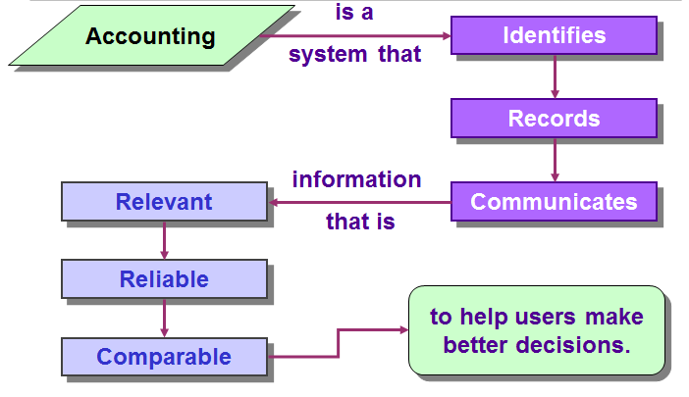
Importance of Accounting

Slide 6
The accounting process
Accounting “links” decision makers with economic activities ⎯ and with the results of their decisions.
Economic activities
Accounting
information
Actions (decisions)
Decision makers
Notes:
3

Slide 7

Types of Accounting Information
Financial
Tax
Managerial
Notes:
3

Slide 8
Information System
Cost & Revenue Determination
Job costing
Process costing
ABC
Sales
Assets & Liabilities
Plant and
equipment
Loans & equity
Receivables,
payables & cash
Cash Flows
From operations
From financing
From investing
Information Users
Investors
Creditors
Managers
Owners
Customers
Employees
Regulatory
agencies
e.g-SEC
Decision Support
CVP analysis
Performance
evaluation
Incremental
analysis
Budgeting
Capital
allocation
Earnings per
share
Ratio analysis
Notes:
3

Slide 9



Basic Functions of an Accounting System
Interpret and record business transactions.
Payment
Car

Slide 10

Basic Functions of an Accounting System
Interpret and record business transactions.
Classify similar transactions into useful reports.
Summarize and communicate information to decision makers.

Slide 11
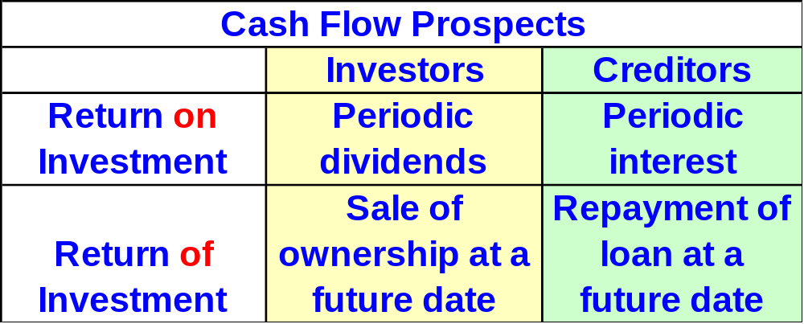
Objectives of External Financial Reporting
The primary external users of financial information are investors and creditors.
Notes:
3

Slide 12
(Specific)
Information about economic resources, claims to resources, and changes in resources and claims.
Objectives of Financial Reporting
Information useful in assessing amount, timing and uncertainty of future cash flows.
Information useful in making investment and credit decisions.
(General)
Notes:
3

Slide 13


Objectives of External Financial Reporting
Income Statement
Balance Sheet
The primary financial statements.
Statement of Cash Flows

Slide 14



Financial Statements:
A Lens to View Business
Financial Reporting
Financial Statements
Financial Reporting
Notes:
3

Slide 15

Characteristics of Externally Reported Information
A Means to an End
Usefulness Enhanced via Explanation
Broader than Financial Statements
Based on General Purpose Assumption
Historical in Nature
Results from Inexact and Approximate Measures
Notes:
3

Slide 16

Internal Users of Accounting Information
Board of Directors
Chief Executive Officer
Chief Financial Officer
Vice Presidents
Business Unit Managers
Plant Managers
Store Managers
Line Supervisors
Notes:
3

Slide 17
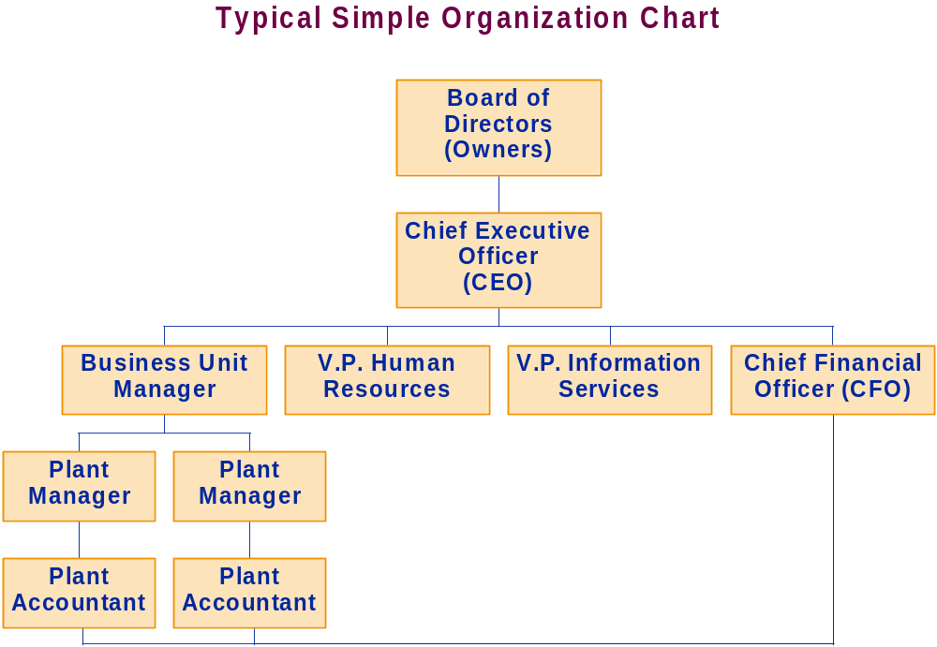
Notes:
3

Slide 18
Information about decision-making
authority, for decision-making support, and for evaluating and rewarding decision-making performance.
Objectives of Managerial Reporting
Information useful in assessing
both the past performance and future directions of the enterprise and information from external and internal sources.
Information useful to help the enterprise achieve its goal, objectives and mission.
Notes:
3

Slide 19

Characteristics of Management Accounting Information
Timeliness
Identify Decision-Making Authority
A Means to an End
Measures of Efficiency and Effectiveness
Oriented Toward Future
Notes:
3

Slide 20

Integrity of Accounting Information
Institutional Features
Generally Accepted Accounting Principles (GAAP)
Financial Accounting Standards Board
Securities and Exchange Commission
International Accounting Standard Board
International Financial Reporting Standards
Notes:
3

Slide 21
Integrity of Accounting Information
Professional Organizations
Institute of Chartered Accountants of Pakistan
American Institute of Certified Public Accountants
Institute of Management Accountants
Institute of Internal Auditors
American Accounting Association
Notes:
3

Slide 22
Integrity of Accounting Information
Competence, Judgment and Ethical Behavior
Chartered Accountancy (CA)
Certified Public Accountants (CPAs)
Certificate in Management Accounting (CMA)
Certificate in Internal Auditing (CIA)
Code of Professional Conduct
CPA
Notes:
3

Slide 23
Exercises
Boeing Company is the largest manufacturer of commercial aircraft in the United States and is a major employer in Seattle, Washington. Explain why each of the following individuals or organizations would be interested in financial information about the company.
California Public Employees Retirement System, one of the world’s largest pension funds.
China Airlines, a rapidly growing airline serving the Pacific Rim.
Henry James, a real estate investor considering building apartments in the Seattle area.
Boeing ’s management.
International Aerospace Machinists, a labor union representing many Boeing employees.

Slide 24
Solution
Part-a
As one of the world’s largest pension funds, California Public Employees Retirement System (Cal PERS) also is one of the world’s largest stockholders. Cal PERS uses Boeing’s financial statements and other financial information to decide whether to include the capital stock of Boeing Company in its investment portfolio.
Part-b
As a rapidly growing airline, China Airlines may be a major customer of Boeing for the foreseeable future. Before ordering aircraft (which are ordered years in advance of the delivery dates), China Airlines will want to determine that the manufacturer has the financial capacity to fulfill the contract and to stand behind its aircraft in years to come. (Aircraft manufacturers, like automakers, sometimes must recall planes to correct defects discovered after years of use.)

Slide 25
Solution
Part-c
Boeing’s financial health and future prospects affect the demand for housing (and apartments) in much of the Seattle area. Nonetheless, whether Boeing is hiring or laying off workers still is significant—especially in those areas within comfortable traveling distance of Boeing’s facilities.)
Part-d
Management is responsible for planning future operations, using the company’s resources efficiently, and generally running the business. These responsibilities require constant use of detailed accounting information about past, current, and expected future operations.
Part-e
The financial health and future prospects of Boeing affect the contracts that labor unions will be able to negotiate. Boeing’s backlog of unfilled orders basically determines who is in the “catbird seat” in labor negotiations—the company or the union.

Slide 26
Exercise
You recently invested $12,000 of your savings in a security issued by a large company. The security agreement pays you 7 percent per year and has a maturity two years from the day you purchased it. What is the total cash flow you expect to receive from this investment, separated into the return on your investment and the return of your investment?

Slide 27
Solution
You expect two cash flows from your investment:
Return of investment (at maturity) ……………………………………. $12,000
Return on investment (periodically, as stated in your investment
agreement ($12,000 × 7% × 2 years) …………………………………… $1,680
Total expected cash flow (12000+1680)………………………………….. $13,680
The return of your investment will come at one time—two years later at the maturity date. The return on the investment can come in different patterns. For example, if it is semi-annually, you would receive $420 ($12,000 × 7% × 1/2 year) four times. If it is annually, you would receive $840 ($12,000 × 7%) two times. If it is monthly, you would receive $70 ($12,000 × 7% × 1/12) 24 times.

Slide 28

End of Chapter 1
Notes:
4

